Slide 1



Tuning into 92.7 FM HISTORY
SQL ANALYSIS
PRESENTED BY - ANURAG DUBEY

Slide 2


PROJECT OVERVIEW
Our project delves into the vibrant world of Big FM 92.7, employing MySQL for in-depth data analysis. With a focus on stations, hosts, shows, and partnerships, our objective was to uncover valuable insights. Leveraging MySQL's robust capabilities, we navigated through the database to reveal trends, showcase host achievements, and identify strategic partnerships. This overview encapsulates the essence of our exploration, highlighting the power of MySQL in extracting meaningful information from the extensive dataset of Big FM 92.7

Slide 3

TABLES -
Stations
Hosts
Shows
Partnerships
ShowPartnerships
Awards
OnlinePresence

Slide 4
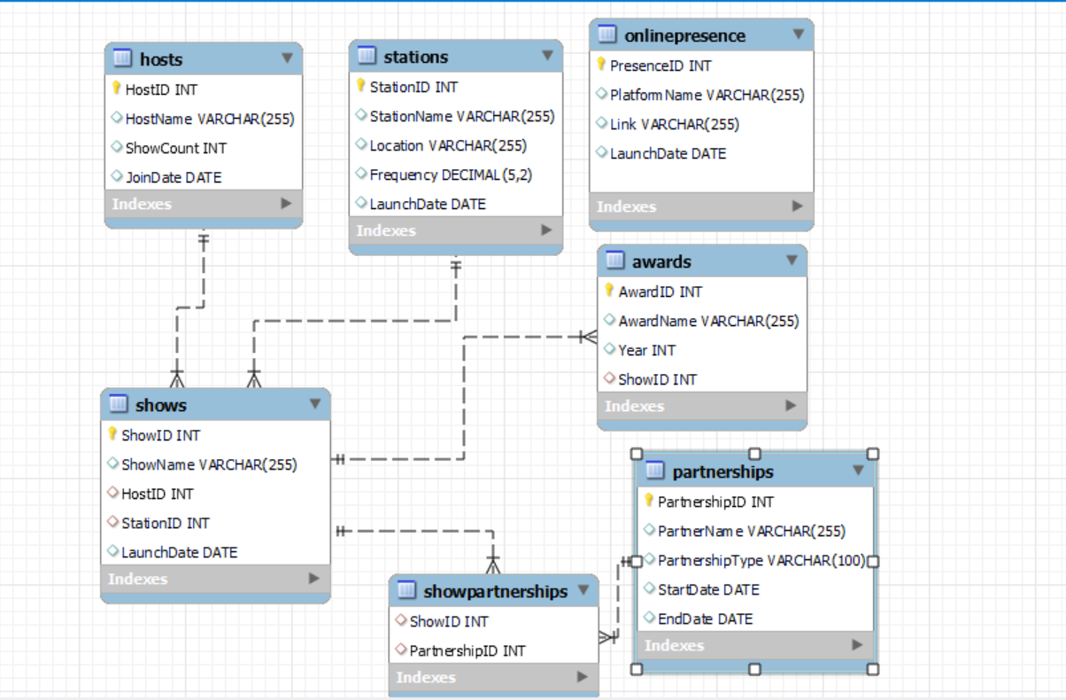


Slide 5
Retrieve all stations in the "East" region?
select * from stations where location='East';

Slide 6


List all shows hosted by "Vrajesh Hirjee"?
select h.HostID,
h.HostName,
s.ShowName
from hosts h left join shows s on h.HostID=s.HostID
where HostName="Vrajesh Hirjee";

Slide 7
Count the number of awards each show has won?
select ShowName,Count(AwardID) as 'Number of Awards'
from awards a inner join shows s on a.ShowID=s.ShowID
group by ShowName
order by 2 desc;

Slide 8
Find shows that have partnerships with "Spotify"?
select s.ShowName
from Partnerships p inner join ShowPartnerships as sp on p.PartnershipID=sp.PartnershipID
inner join shows s on s.ShowID=sp.ShowID
where PartnerName='Spotify';

Slide 9
Retrieve hosts who joined before 2010?
select HostName,JoinDate
from hosts
where YEAR(JoinDate)<2010;

Slide 10
List the shows and their launch dates in descending order of launch date?
select ShowName,
LaunchDate
from shows
order by LaunchDate desc;

Slide 11
Find the total count of shows for each host?
select HostName,
ShowCount
from hosts
order by 2 desc;

Slide 12
Show the online presence platforms with their links?
select PlatformName,
Link
from OnlinePresence;

Slide 13
Retrieve the stations in the "South" region launched after 2010?
select *
from stations
where Location='South' and YEAR(LaunchDate)>2010;

Slide 14
Rank hosts based on the number of shows they have hosted?
select HostName,
ShowCount,
dense_rank() over(order by ShowCount desc) as host_rank from hosts;

Slide 15


Thank you
for tuning to 92.7 FM radio station!
feel free to ask any questions

